Slide 1
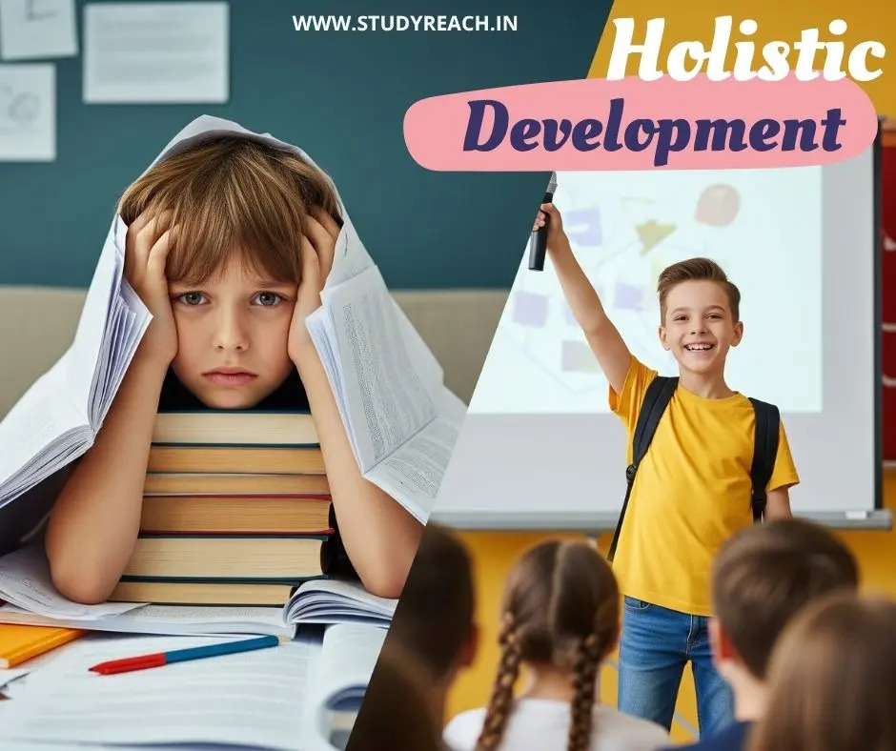

Slide 2
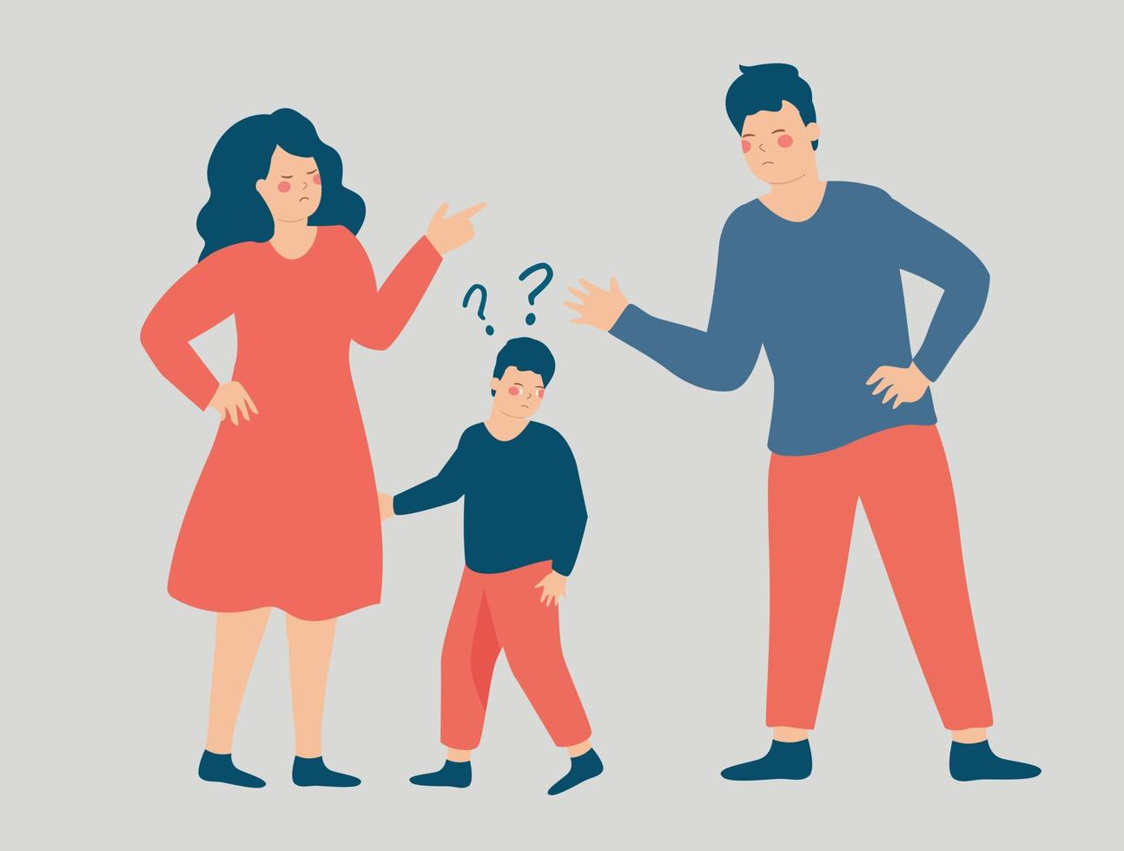
ENGINEER
DOCTOR
SINGER

Slide 3
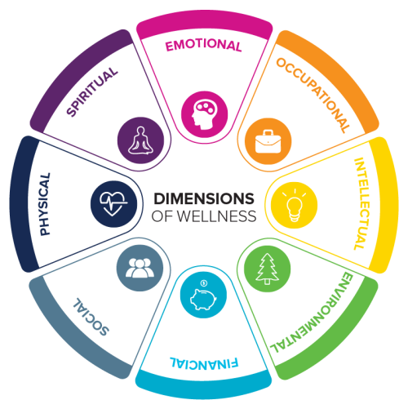
What is Holistic Development?
Holistic development means nurturing every aspect of a child’s personality:
Physical – health, fitness, nutrition
Mental – thinking, problem-solving, creativity
Emotional – handling feelings, empathy, stress management
Social – communication, teamwork, leadership
Spiritual/Moral – values, ethics, purpose

Slide 4
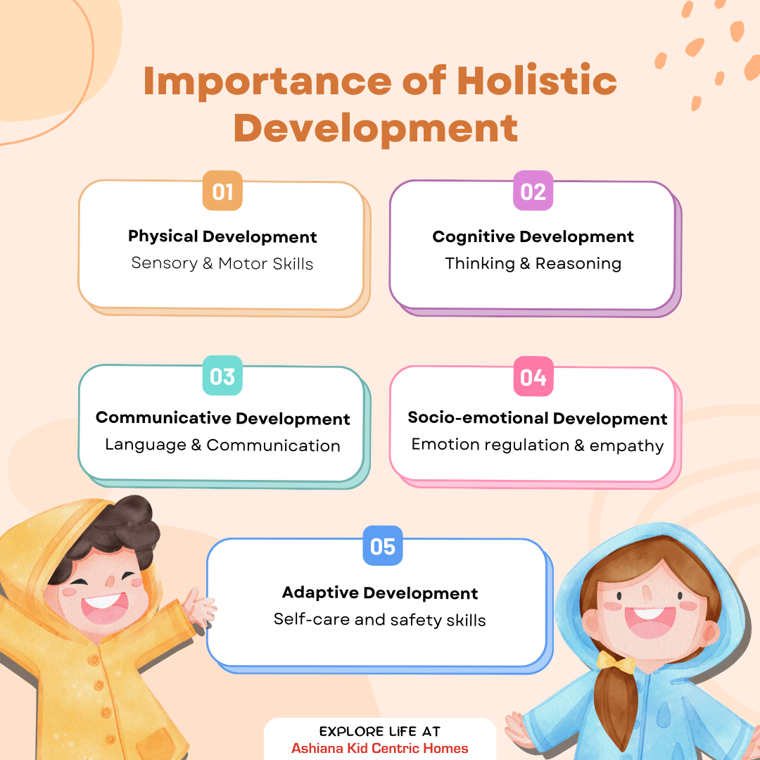
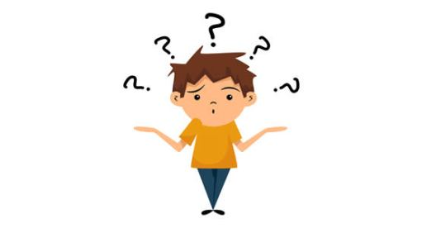
Why HPD Matters?

Slide 5
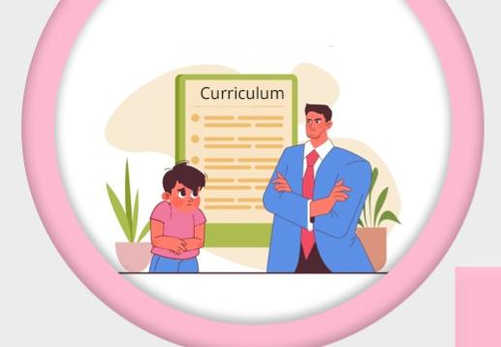

Challenges in HPD
Academic Overload: Excessive focus on academic performance and standardized testing pressures often neglects crucial areas like emotional, social, and physical development.
Curriculum Rigidity: Many educational systems are still structured around traditional, exam-focused learning, making it difficult to incorporate holistic methodologies that go beyond academics.
Teacher Training: There is often a shortage of qualified teachers and insufficient training for educators to implement holistic and life-skill-focused teaching methods.
Lack of Resources: Many schools, especially in under-resourced areas, lack the necessary materials, facilities, and infrastructure to support holistic development, which requires resources for creative, physical, and outdoor activities.

Slide 6
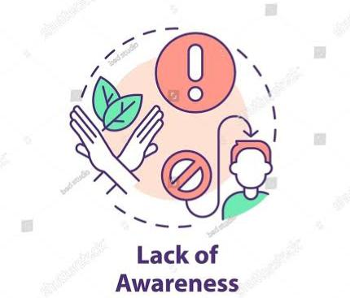

Digital distractions: Overuse of technology and digital media can distract from offline activities essential for imagination, language development, and social interaction.
Socioeconomic factors: A child's background, access to resources, and the support available within their community significantly influence their development.
Lack of community awareness: Insufficient awareness among parents and the community about the importance of non-academic growth can hinder efforts to promote it.
Difficulty with self-regulation: Children can struggle with concentration, discipline, and taking responsibility for their actions, often showing a negative self-image and external locus of control.

Slide 7
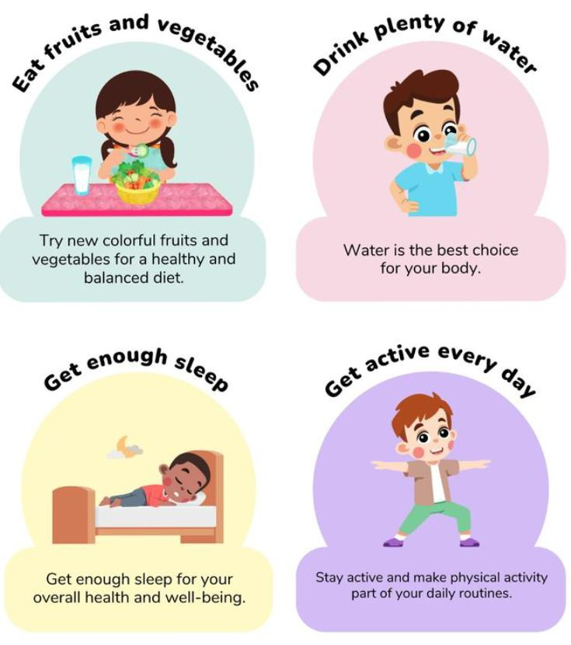
How to Achieve HPD
Promote activity: Encourage a range of physical activities, from organized sports to unstructured play, to build motor skills and physical strength.
Support healthy habits: Ensure children get adequate rest and a balanced, nutritious diet to support their physical health and cognitive functions.
Involve fine motor skills: Provide activities like drawing, puzzles, and play dough to develop smaller movements and dexterity.
Create a Supportive Environment: Provide a safe, nurturing space where children feel secure to express themselves and seek help when needed.
Build Strong Relationships: Establish warm, caring relationships by responding to children's initiatives, talking calmly, and offering comfort.

Slide 8
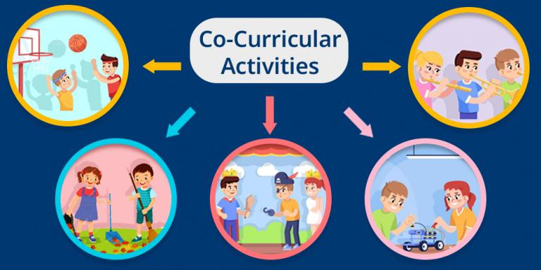
Activities to Improve HPD

Slide 9
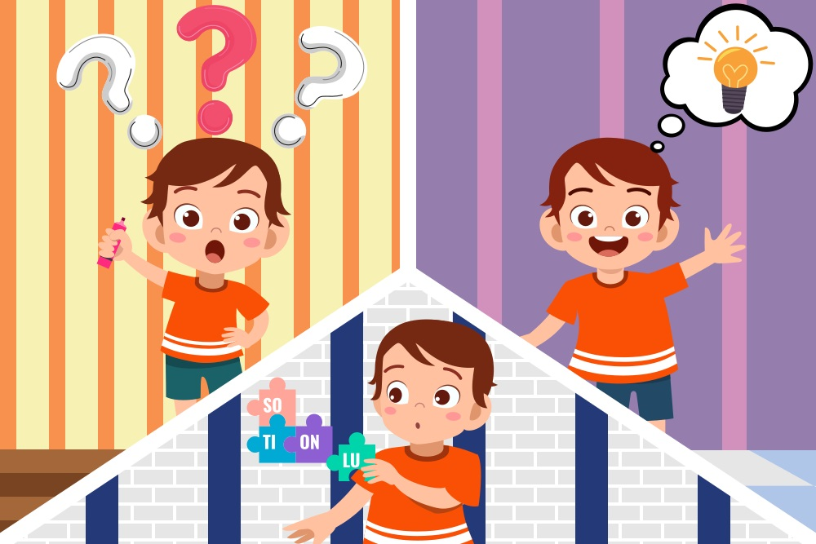
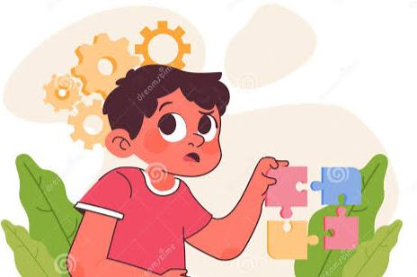
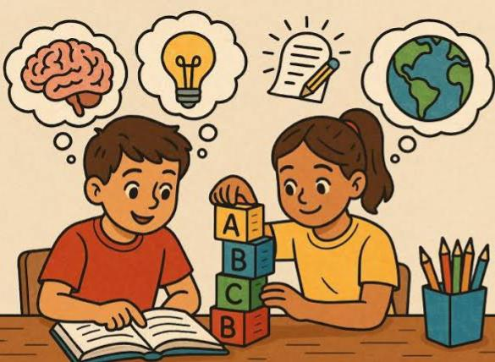

Slide 10

THANK YOU
Health is a state of complete mental, social and physical well-being, not merely the absence of disease or infirmity".

